Slide 1

Transcription Analysis
Presented by: Abhishek Kumar

Slide 2
Task 1: GenAI
Problem Statement:
The accompanying file titled transcripts_v2.zip contains examples of call transcripts with both the agent and customer transcripts being provided.
Question 1: Use a large language model of your choice to analyse the customer side of the transcript only and:
1. Identify the sentiment (positive, negative, neutral) of the call
2. Determine call outcome (issue resolved, follow-up action needed)
Question 2: Use appropriate metrics to monitor the performance of your model.
Question 3: Use methods of your choice (example. exploratory data analysis, statistical methods, visualizations etc.) to extract useful insights from the data.

Slide 3
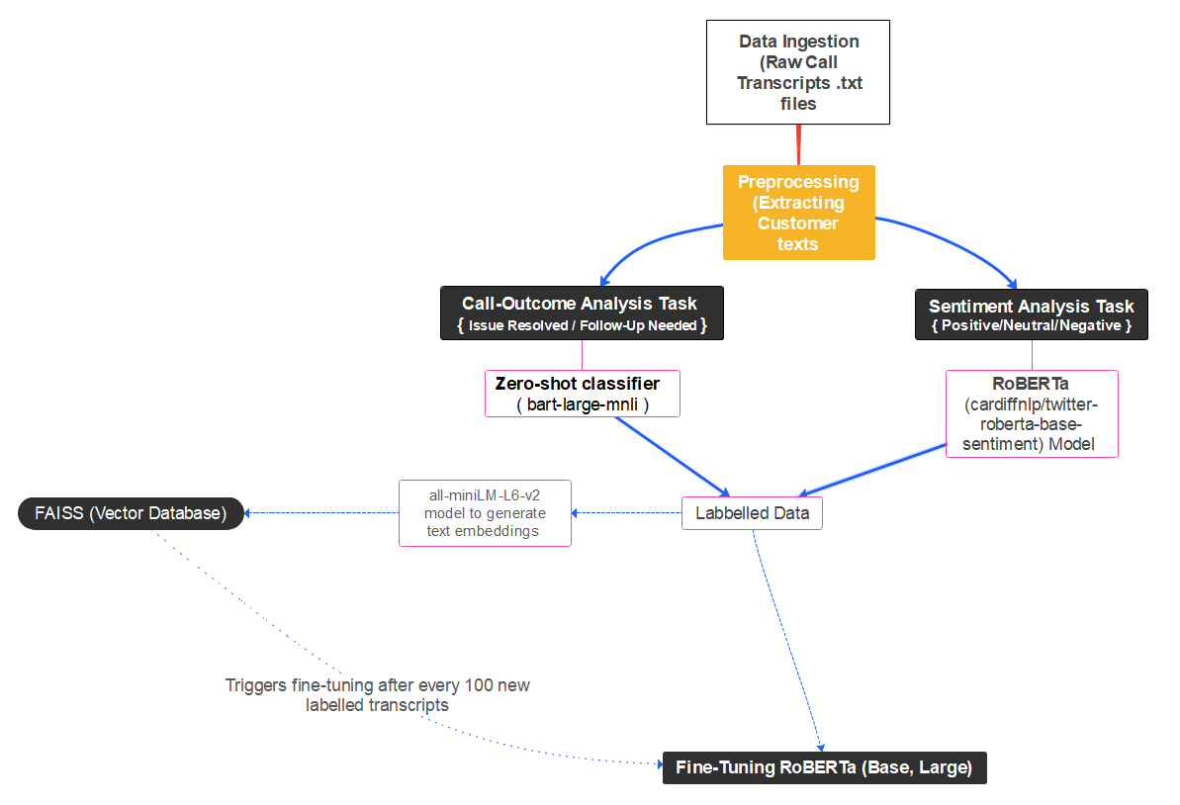
Architecture Diagram

Slide 4
Approach Overview: How we can analyse this problem
Two LLM’s Used:
RoBERTa (cardiffnlp/twitter-roberta-base-sentiment) for Sentiment Analysis (Positive, Neutral, Negative)
BART (facebook/bart-large-mnli) for Zero-Shot Outcome/Status Classification
Pipeline:
Extract only 'Member' responses from transcripts.
Sentiment Analysis using RoBERTa.
Zero-Shot Classification using BART for Issue Resolution.
Output structured results for further analysis or customer insights.

Slide 5
Why use RoBERTa for Sentiment Analysis?
Model: cardiffnlp/twitter-roberta-base-sentiment
Pre-trained on Conversational Data.
Supports three-class sentiment detection unlike other BERT based models (which only detects positive and negative).
This model excels at detecting frustration, dissatisfaction, and gratitude in short-form text.
Pre-trained, No need for fine-tuning (Already trained on real-world sentiment tasks).

Slide 6
Zero-Shot Classification
A text classification task where a model assigns a label it wasn’t explicitly trained on.
Uses Natural Language Inference (NLI) to understand which label fits best.
Example:
Text: “I haven’t received my refund yet”.
Candidate labels: “Issue resolved” vs “Follow-up Needed”
The model predicts the most relevant category based on textual meaning.
Helps models understand the relationship between two pieces of text (premise & hypothesis).
By default, the zero-shot classification pipeline selects facebook/bart-large-mnli.

Slide 7
Performance Evaluation Methods
Since we started with unlabeled, human verification is essential:
Manual Review of Sampled Predictions -> We can take 20-30 randomly selected transcripts and check whether the sentiment and outcome matches actual human perception
Agreement Score (Inter-Annotator Agreement) -> Same model is annotating the data transcripts twice. We can use Cohen’s Kappa Score to measure the agreement.

Slide 8
Results & Findings
File | Text | Sentiment | Status
transcript_0.txt | Hi, I'm calling to get a case pre-authorized. ... | positive | Follow-up Needed
transcript_1.txt | Hi, I'm calling about a denied claim I receive... | negative | Follow-up Needed
transcript_2.txt | Hi, I'm calling about my recent doctor's visit... | positive | Issue Resolved
transcript_3.txt | Hi, I'm calling about my recent visit to the d... | negative | Follow-up Needed
transcript_4.txt | Hi, I'd like to schedule an appointment with a... | positive | Follow-up Needed
... | ... | ... | ...
transcript_195.txt | Hi, I'm calling about my online service accoun... | negative | Issue Resolved
transcript_196.txt | Hi, I'm calling to schedule an appointment wit... | positive | Issue Resolved
transcript_197.txt | Hi, I'm calling to get a case pre-authorized. ... | positive | Issue Resolved
transcript_198.txt | Hi, I'm calling about my recent visit to the d... | positive | Issue Resolved
transcript_199.txt | Hi, I'm calling about a denied claim. I receiv... | positive | Issue Resolved
Table 1: Output Data after Sentiment Analysis and Outcome Classification

Slide 9
Results & Findings
File | Text | Sentiment | Outcome
transcript_0.txt | Hi, I'm calling to get a case pre-authorized. My name is Emily Wilson and my member ID is MEM456789. It's March 12, 1985. I'm scheduled to undergo an MRI scan for a knee injury. My doctor's office has already submitted the request, but I wanted to confirm the status and ensure that it's covered under my plan. Sure, thank you. My doctor's name is Dr. Smith and the facility is Oakwood Medical Center. Okay. Okay, what does that mean? Okay, that sounds good. Can you give me a reference number for this case so I can follow up if needed? Great, thank you for your help. No, that's all. Thank you. | positive | Follow-up Needed
Table 2: Example of Transcript after Extracting Member Responses

Slide 10
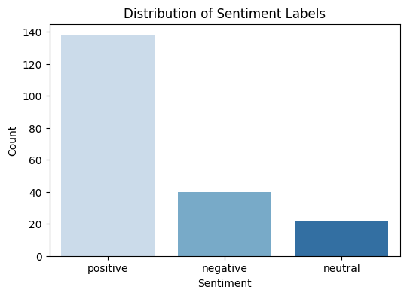
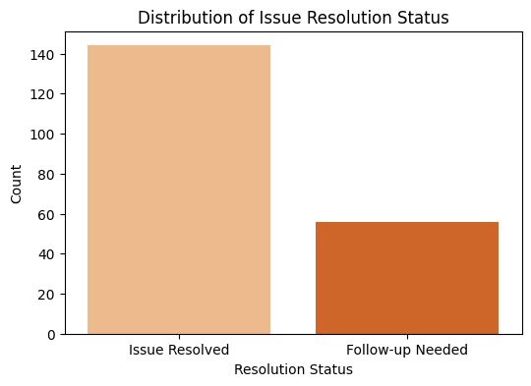
Results & Findings
Figure 1: Distribution of Sentiment Labels
Figure 2: Distribution of Outcome Labels
Majority Positive Sentiment (≈ 140 cases)
suggests that most customer interactions have satisfactory or resolved outcomes. This could be a reflection of effective customer service, quick claim resolutions, or positive experiences.
2. Moderate Negative Sentiment (≈ 40 cases)
A notable portion of interactions still express dissatisfaction. These could be delayed claims, policy disputes, denied coverage, or customer frustration with service speed.
The high proportion of "Issue Resolved" cases suggests that the customer support is effectively addressing most concerns.
This aligns with the high positive sentiment observed in the previous graph, indicating that many customers are satisfied with the resolution process.

Slide 11
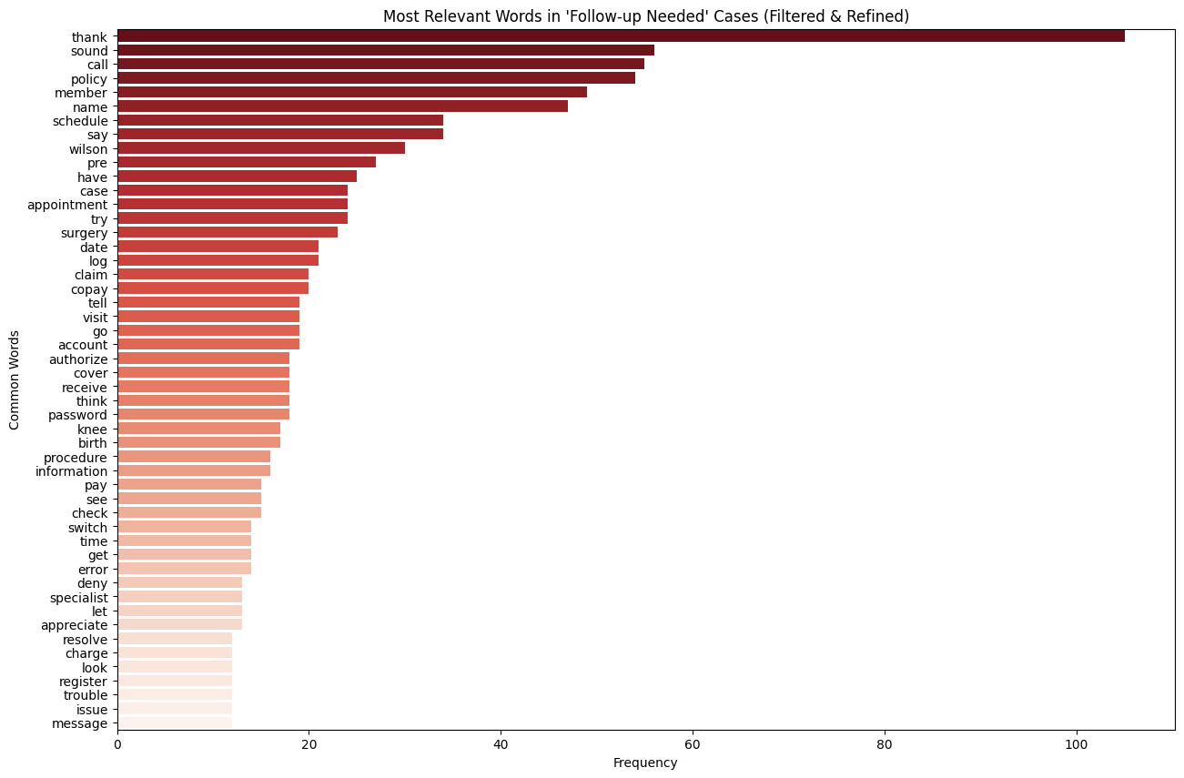
Results & Findings
Figure 3:Most Relevant Words – ‘Follow-Up Needed’ Case
Insurance-Specific Terms Are Prominent
"Policy," "Claim," "Copay," "Coverage," "Authorize" → These are directly related to insurance claims, billing, and approvals. This confirms that many follow-up cases are linked to claims, eligibility, or payment disputes.
2. Health & Medical Terms Appear in Follow-up Cases
"Surgery," "Procedure," "Specialist," "Appointment," "Birth," "Knee" → These indicate that many unresolved cases involve medical claims, scheduling, and approvals.
3. Technical & Account Issues Are Common
"Password," "Account," "Register," "Log," "Switch" → These suggest that some follow-up cases are due to login, security, or registration issues. Not all follow-up cases are claims-related—some are digital access issues.

Slide 12
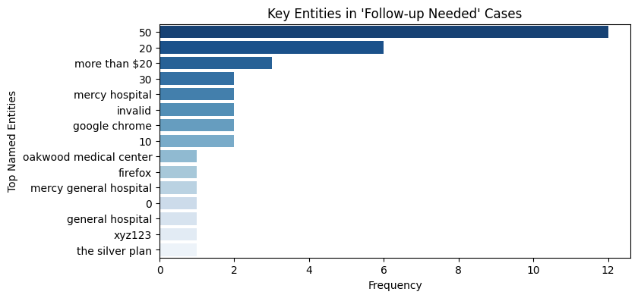
Results & Findings
Figure 4: Key Entities – ‘Follow-Up Needed’ Case
1. Frequent Mentions of Dollar Amounts ("50", "20", "more than $20")
The most common named entities relate to monetary amounts, indicating many follow-up cases involve billing disputes, claim amounts, or unexpected charges.
2. Multiple Hospital & Medical References ("Mercy Hospital", "Oakwood Medical Center", "General Hospital")
Health insurance claims & medical billing are a major source of follow-ups.
Hospitals being frequently mentioned suggests customers are contacting regarding medical claim approvals, denied procedures, or hospital billing issues.
3. Technical Terms ("Google Chrome", "Firefox", "Invalid") Appear in Follow-up Cases
Mentions of browsers suggest digital or login-related issues, possibly affecting online account access.
The word "invalid" might relate to invalid credentials, denied claims, or system errors preventing account access.
4. Insurance Plan Mentions ("The Silver Plan")
Specific plan names appearing in follow-ups could mean certain insurance products have higher customer concerns.

Slide 13
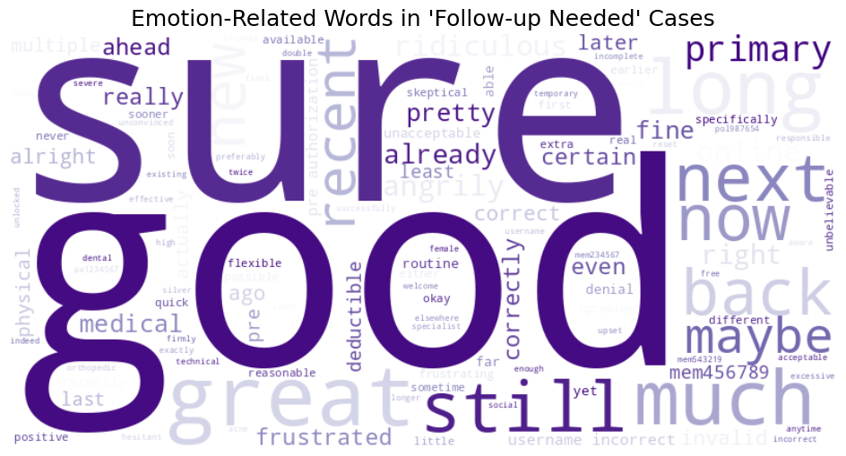
Results & Findings
Figure 5: Emotion Related Word Cloud – ‘Follow-Up Needed’ Case
Unexpectedly Positive Words ("Good", "Great", "Sure") Appear in Follow-up Cases
2. Frustration Indicators Exist but Are Less Dominant ("Frustrated", "Ridiculous", "Upset")
Possible explanation: Customers might avoid aggressive language in formal insurance queries, making it harder for models to detect genuine frustration.
3. Timing & Urgency Words Appear ("Now", "Next", "Still", "Later", "Recent")
Customers are concerned with delays, next steps, or how long a case remains unresolved.
This suggests that many follow-up cases are due to pending approvals, slow responses, or missing updates.

Slide 14
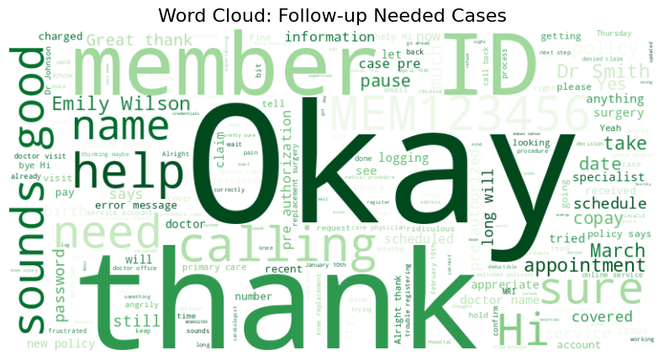
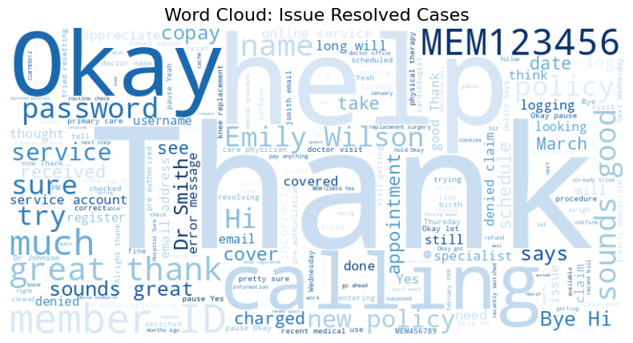
Results & Findings
Figure 6: Word Cloud – ‘Follow-Up Needed’ Case
Figure 7: Word Cloud – ‘Issue Resolved’ Case

Slide 15
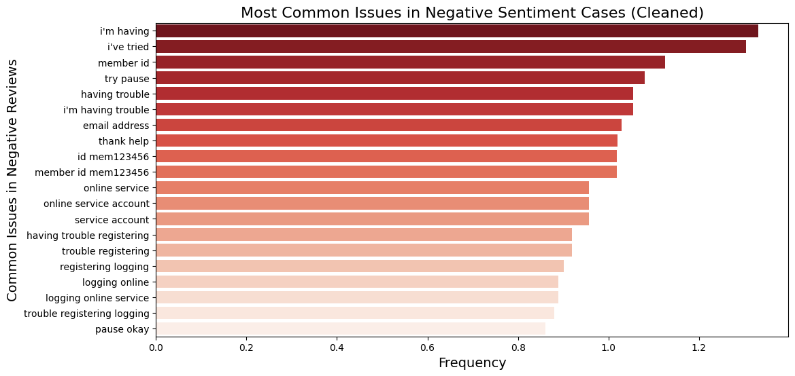
Results & Findings
Figure 8:Most Common Issues in Negative Sentiment Cases
High Frequency of "I'm Having" and "I've Tried" Indicates Ongoing Struggles
The top issues include phrases like "I'm having" and "I've tried," suggesting that customers are repeatedly facing difficulties despite attempting solutions.
2. Account & Login Issues Are Major Sources of Negative Sentiment
"Email address," "Online service," "Logging online," "Trouble registering" indicate that many negative cases stem from customers struggling with account access.
3. Frequent Mentions of "Member ID" Suggest Identity Verification Challenges
Terms like "Member ID," "ID mem123456" appearing frequently indicate that users often need to verify their identity or retrieve account information.

Slide 16
Future Enhancements: FAISS & Fine-Tuning
Goal: A highly efficient, self-learning, adaptive LLM model for automated sentiment & outcome classification.
1. Fine-Tuning RoBERTa for Sentiment Analysis and Outcome Classification.
RoBERTa-Base → Sentiment Analysis.
RoBERTa-Large → Call Outcome Classification.
Trained with class balancing & optimized tokenization.
2. FAISS for Vector Storage & Continuous Learning
Stores past labeled cases as embeddings for fast retrieval based on similarity score.
New queries are matched with similar cases, reducing model inference load.
Active Learning: Triggers auto-fine-tuning after every 100 new cases.
3. Long-Term Vision: AI-Driven Self-Improvement
FAISS initially aids classification, but model improves with each iteration.
Eventually, model generalizes so well due to continuous learning and fine-tuning on new transcripts that FAISS is no longer needed.
Creates a near-human level classification system with minimal retraining.
4. For long-term scaling: Implementing Drift Detection (KL Divergence) and Explainability (SHAP/LIME) to monitor the model performance.
Ensuring the model remains relevant as business language & customer behavior evolve.

Slide 17
Final Takeaways: Business and AI Impact
LLM-Driven Automation Saves Time & Costs of Manual Annotating.
Proactively Identifies Customer Pain Points.
Zero-Shot Classification Enables Scalability.
Real-Time Sentiment Monitoring Improves Retention.
FAISS + Fine-Tuning = Continuous Learning.
Business Impact: Smarter, Faster, and More Customer-Centric AI.
Predict & resolve customer dissatisfaction before escalation.

Slide 18

Q&A: Thank You!
Happy to answer any questions!

